Slide 1
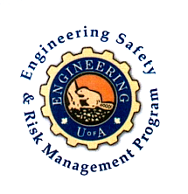
Fundamentals of RM
RM System and Process
Leadership in RM
Incident Investigation
RM Tools & Challenges
RM in Industry
People & Org.
Application and Perspectives
On Becoming a Leader
in Risk Management
ENGG404 - Lecture
Chapter 3.3: RME #04
Management of Change (MOC)

Slide 2
Learning Outcomes:
Explain the purpose of a basic Management Of Change (MOC) work process, the manner in which it is used, and the benefits for managing change.
Explain the need to manage change by gaining an appreciation about the potential changes in risk as a change in the activity, the technology of the operation, or organization (structure and people) is made.
Explain the significance of the “Management of Change” element in a Risk Management System.
Apply the basic MOC work process.
Chapter 3.3: RME #04 Management of Change (MOC)
2
Notes:
2

Slide 3
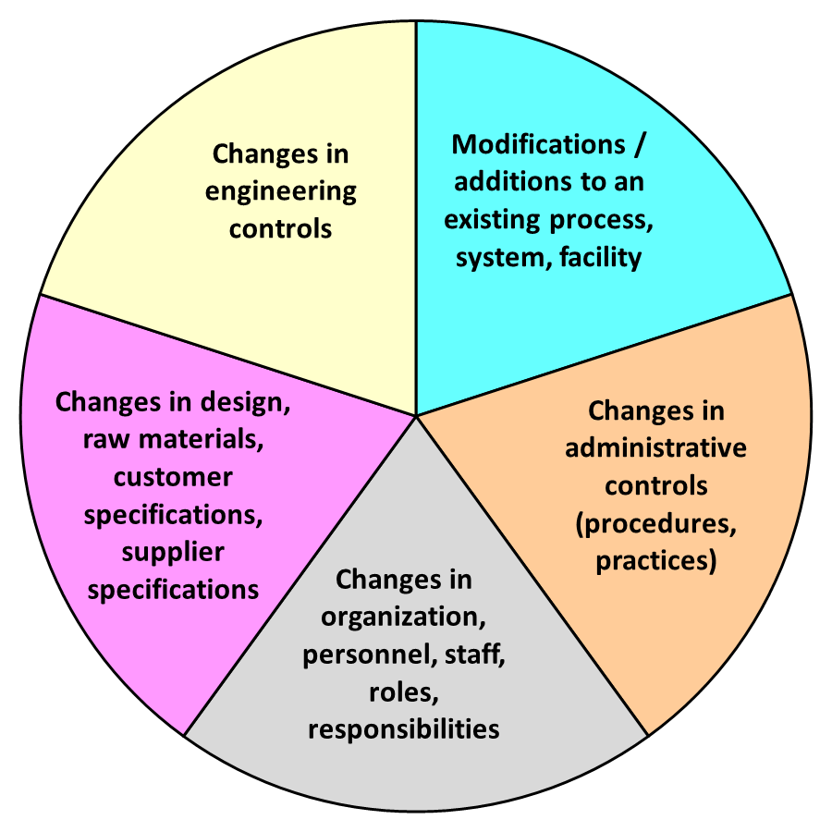
Introductory Points About “Change”.
Change is Normal Part of Business:
Change requires appropriate management system oversight to ensure that the change does not introduce new risks, or change control measures for existing risks.
Look at Change in Terms of a
Change in Risk Level:
Does the change introduce a
new or different risk, or affect
the effectiveness of existing
control measures (administrative
controls and/or engineering
controls)?
Management of Change Applies To:
Almost any kind of change!
Chapter 3.3: RME #04 Management of Change (MOC)
3
Notes:
3

Slide 4
How is MOC linked to the Risk Management System?
Management Leadership, Commitment and Accountability.
Risk Assessment and Management of Risks.
Community Awareness and Emergency Preparedness.
Management of Change.
Incident Reporting, Investigation, Analysis and Actions.
Program Evaluation and Continuous Improvement.
Design, Construction and Start-up.
Operations and Maintenance.
Employee Competency and Training.
Contractor Competency and Integration.
Operations and Facilities Information and Documentation.
You can expect that everywhere you go in your career the organization will have a MOC program. MOC is almost universal.
And if it doesn’t, what are you going to do?
Implement a “Management of Change” Program in areas
under your responsibility.
Chapter 3.3: RME #04 Management of Change (MOC)
4
Notes:
4

Slide 5
ALE #1: MOC Basic Examples
Please confer, and respond. (pen-to-paper / MM-MC):
When should MOC apply? Select as YES or NO.
1) I bought a new piece of equipment to replace an old one.
1a) NEW is same as OLD, same operating procedures:
1b) NEW is different from OLD, different operating procedures:
2) My design lead engineer retired & I appointed a replacement.
3) Our organization was bought by a larger enterprise and we need to follow their administrative controls (policies, protocols, etc.).
4) The ore host rock has changed and we need to adjust the extraction processes.
4a) Within expected changes & extraction process design limits:
4b) Outside expected changes & extraction process design limits:
Chapter 3.3: RME #04 Management of Change (MOC)
5
Notes:
5

Slide 6
Example: MOC Basic Examples
MOC should or should not apply as shown:
1) I bought a new piece of equipment to replace an old one.
1a) NEW is same as OLD, same operating procedures: NO
1b) NEW is different from OLD, different operating procedures: YES
2) My design lead engineer retired & I appointed a replacement. YES
3) Our organization was bought by a larger enterprise and we need to follow their administrative controls (policies, protocols, etc.). YES
4) The ore host rock has changed and we need to adjust the extraction processes.
4a) Within expected changes & extraction process design limits: NO
4b) Outside expected changes & extraction process design limits: YES
Chapter 3.3: RME #04 Management of Change (MOC)
6
Notes:
6

Slide 7
Who is Responsible for Management of Change?
Several Roles:
Several roles involved in managing the change, each becomes involved as the proposed change progresses through the work process.
Recall RACI: Responsible, Accountable, Consulted, Informed
The Change Owner (Person driving the change): Responsible
The Stakeholders: Informed, Consulted
Subject-matter Experts: Responsible, Consulted, Informed
  Managers.
  Those affected by or subject to the change.
  Those who will implement the change.
Final Approver: Accountable for ensuring that the MOC work process has been followed!
Chapter 3.3: RME #04 Management of Change (MOC)
7
Notes:
7

Slide 8
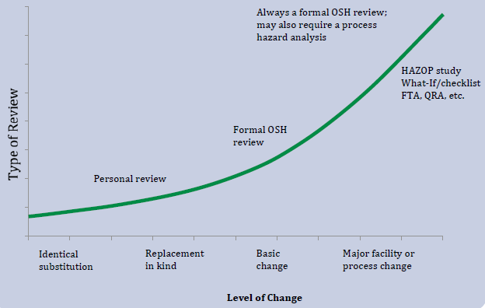
Type of Risk Assessment & Level of Change
Matching the type of risk assessment to the level/complexity of the change is a critical part of the management of change process.
Chapter 3.3: RME #04 Management of Change (MOC)
8
Notes:
8

Slide 9
Four Critical Actions for MOC:
Four Critical Actions:
The Change Owner must drive these four actions in MOC:
Every organization may have different
procedures for each action
These 4 critical actions are integrated within
the MOC WP!
(1)
Communicate the Proposed Change
(2)
Conduct Appropriate Reviews & Risk Assessments
(3)
Seek Final Approval
(4) Communicate & Implement the Change
Chapter 3.3: RME #04 Management of Change (MOC)
9
Notes:
9

Slide 10
Management of Change is Critical!
The causes of many incidents include the failure to:
Communicate the change;
Conduct appropriate reviews and risk assessments;
Seek and gain final approval;
Implement the change as agreed upon and approved by all stakeholders.
Can weaknesses in the MOC Program be latent causes?
YES
NO
NOT SURE
Is RME #4 MOC “stand-alone” or is it integrated?
Stand-alone
Integrated
NOT SURE
Chapter 3.3: RME #04 Management of Change (MOC)
10
Notes:
10

Slide 11
MOC and How it is Integrated Into the RM System:
MOC is NOT Stand-alone – a proposal triggers this typical process:
Each system element within the RM
Program assesses risks relevant to its
scope, and determines the necessary
detailed changes.
A decision is made, a management /
leadership decision, on a risk-informed
basis as to proceed or not.
If risks can be managed to an
acceptable level, then costs are
estimated for all design changes; a
decision is made on an economic basis
as to proceed or not.
Change Proposed:
A Proposal to change an existing process is made.
#4 MOC:
MOC WP identifies the necessary risk assessments.
#2 RA&MR:
These risk assessments identify the necessary safeguards.
#7 DC&SU:
The Design Review Process specifies design changes and costs estimates.
#8 O&M:
Changes to procedures are identified.
#1 MLCA:
Accept all of these changes (and costs for changes) and proceed, or reject.
#9 EC&T:
Training on revised procedures and procesas are identified.
#3 CA&EP:
Changes to emergency preparedness are identifed.
Chapter 3.3: RME #04 Management of Change (MOC)
11
Notes:
11

Slide 12
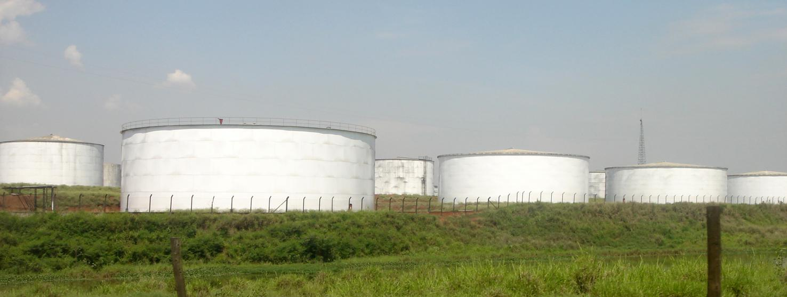
ALE #2: Proposal to Convert a Storage Tank from Jet Fuel to Gasoline
Please confer (Open discussion):
Proposal: Convert a Storage Tank from Jet Fuel to Gasoline
You are part of a team of design engineers at an energy company.
The fuel distribution depot consists of multiple tanks of gasoline and jet fuel.
Because of the recent pandemic and drop in economic activity (pandemic restrictions), the demand for jet fuel has dropped significantly.
The energy company wants your team to convert 2 of the 3 jet fuel storage tanks to gasoline storage. Chemistry note: Jet fuel is combustible (flash point = 36degC / 100degF). Gasoline is flammable (FP = −43degC / −45degF).
Using your field of engineering expertise, what design parameters would need to be considered, and possibly changed, to make this conversion?
Does the application of the MOC WP apply? (MM-Poll)
List 1 or 2 design parameters pertaining to your field of expertise? (Open discussion)
What is the complexity of the overall change – jet fuel tanks to gasoline tanks? (MM-Poll)
Which risk management system elements come into play? (MM-Poll)
There will be many questions about the changes in technology. Whom would you consult? (Response on MM is NOT intended.)
Chapter 3.3: RME #04 Management of Change (MOC)
12
Notes:
12

Slide 13
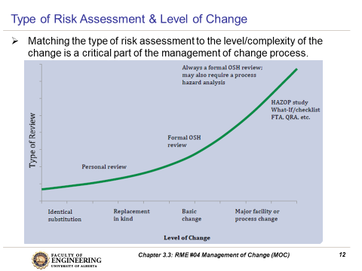
Example: Proposal to Convert a Storage Tank from Jet Fuel to Gasoline
Proposed change: Convert 2 of the 3 jet fuel storage tanks to gasoline storage.
Yes, the MOC work process does apply. A change is being proposed, to this triggers the action to initiate the MOC work process.
Design parameters pertaining to your field of expertise:
The complexity of the overall change: Major Process (significant) Change
These risk management system elements come into play:
#1 MLCA
#2 Risk Assessment and Management of Risk;
#3 Emergency Preparedness;
#4 MOC;
#7 Design, Construction & Startup;
#8 Operations & Maintenance;
#9 Employee Competency & Training;
You should consult with the following SMEs (Subject-Matter Experts):
Chemical Eng. / MechE / Fire Protection Specialist / Operations and
Maintenance Personnel / Trainers / Emergency Response Team, etc.!
Hazardous material (Jet Fuel for Gas) Piping to prevent cross-contamination Tank and piping labelling Procedures and re-training Software process controls (reprogram) Tank wall strength Compatibility of materials of construction | Foundation strength / underground facilities Secondary containment Leak detection systems, alarms, fire protection Instrumentation (recalibrations) Electrical classification Pressure / vacuum relief systems Emissions (air pollution) control systems
Chapter 3.3: RME #04 Management of Change (MOC)
13
Notes:
13

Slide 14
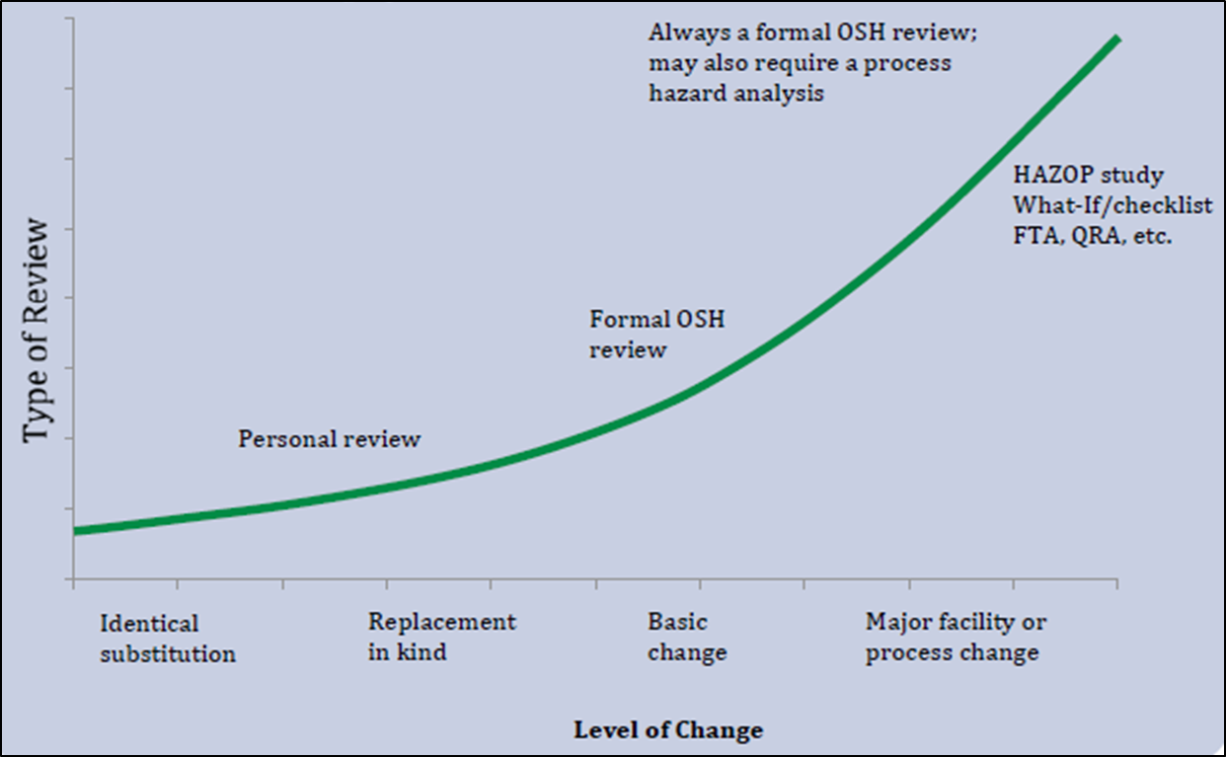
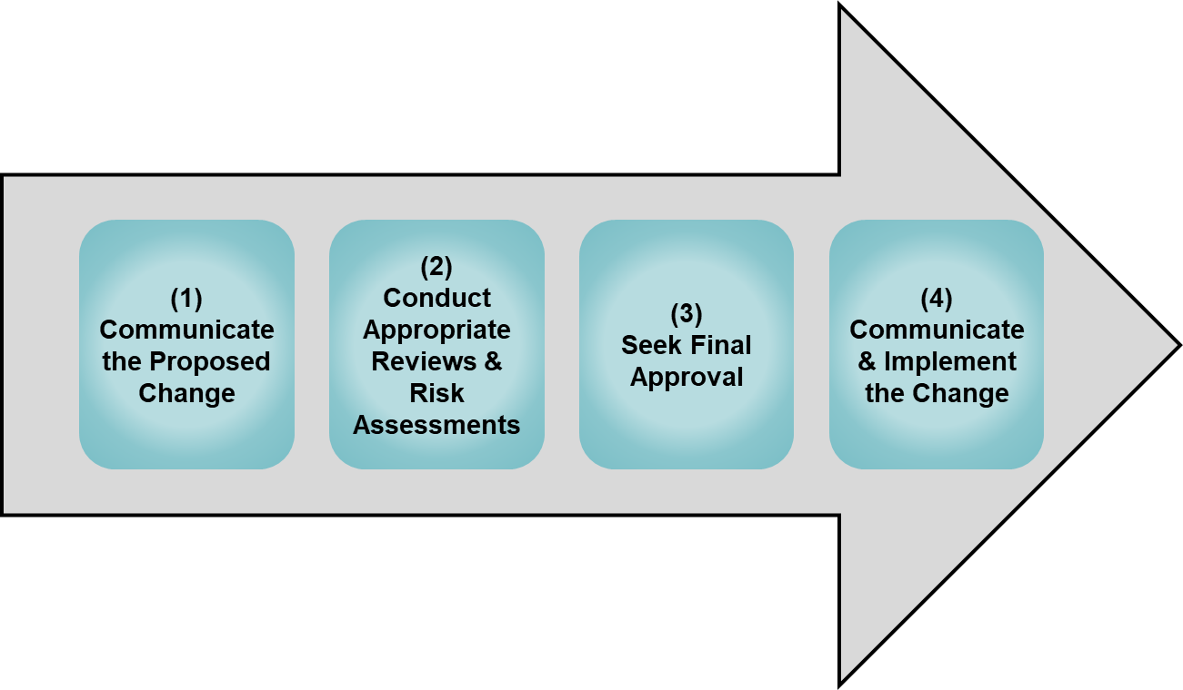
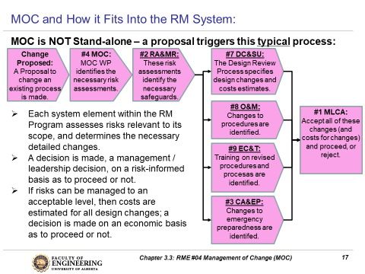
Summary and Key Lesson:
Changes are common occurrences in organizations.
If the word “change” is mentioned in a proposal, it is highly likely that RME #4 MOC and the MOC WP will apply!
MOC WP is applicable at every level of the organization & for every change.
The depth and scope of review in the
MOC depends on the complexity of the
scope of the proposed change.
The four critical actions are essential for
an effective application of MOC WP.
The MOC WP triggers reviews in many other elements.
Change sets the stage for errors …
… and errors lead to loss incidents.
Chapter 3.3: RME #04 Management of Change (MOC)
14
Notes:
14

Slide 15
Any questions?
Notes:
15

